Slide 1
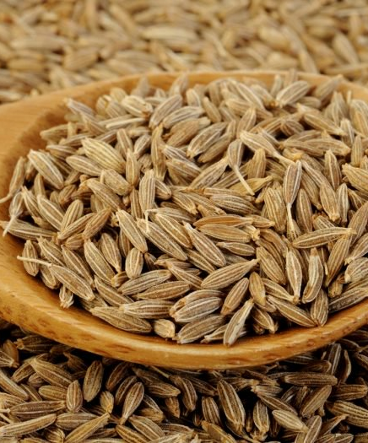
Indian Cumin May 2025 Monthly Report

Slide 2
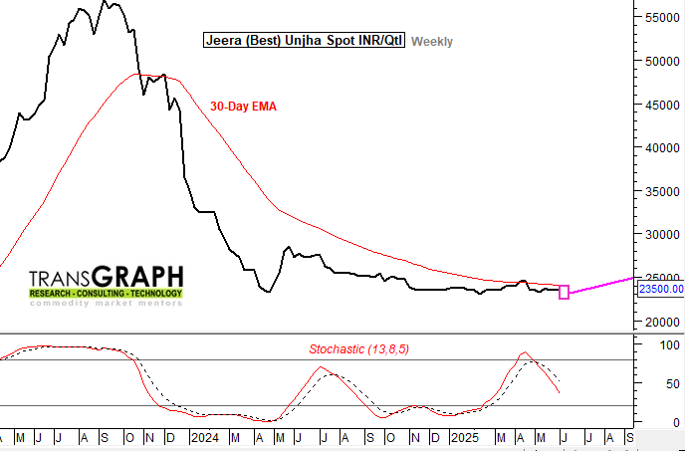
Decrease in Cumin arrivals
Unjha Cumin Arrivals (INR/Qtl)
Indian Cumin production trend
Bearish Factors
Bullish Factors
Despite the lower production the Unjha Market witnessed a 40% higher arrivals from last year in the peak Month of March implies that sellers are offloading stock early.
Lower acreage: This year, the acreage in major producing regions decreased by nearly 22%, driven by last year's. According to TG's initial estimates, total cumin production in India for 2025 is projected at 772 thousand tons which is down by 15% than the previous year, primarily due to the low acreage area.
In addition to ending inventories are expected to be 160.9 thousand tons, marking a 12% decrease from 182.7 thousand tons recorded last year leading to tight carryover stock.
TransGraph Forecast
Cumin prices are expected to stable in July, due to steady demand and controlled supply in the major market.
Jeera spot prices are likely to find support at INR 23200 on any dip and reverse higher toward INR 25000 level by Aug’25.

Slide 3
Cumin Market updates
In the month of May, prices of cumin in the Unjha market remained largely stable and traded at around ₹20250 per quintal. Despite a decline in arrivals compared to the previous month across various markets, the demand from corporate buyers and traders remained subdued. This limited buying interest prevented any significant upward movement in prices, resulting in a steady and range-bound market trend throughout the month.
It was observed that farmers across various markets began releasing their stocks gradually, expecting a potential rise in prices. However, both the prices and the demand remained weak, resulting in a subdued market sentiment.
The demand for cumin from corporates, traders, and retailers is expected to remain lower during the current month of June. This anticipated decline is mainly due to a drop in social functions and weddings after the 16th of June. Additionally, with the reopening of schools and colleges, household consumption typically decreases as many families experience reduced disposable income during this period.

Slide 4
Market updates
In May 2025, a total of 13.7 thousand tons of cumin arrived at the Unjha market, marking a 20% drop compared to the same period last year (17 thousand tons). Similarly, arrivals declined by 31% month-on-month, dropping from 20.12 thousand tons(April’25).
In Jodhpur market in Rajasthan received a total of 1.5 thousand tons of cumin in May 2025, drop by 29% from the same period last year (2.1 thousand tons). In a month-over-months comparison, another trading segment within the Jodhpur region saw a decline of 60%, with arrivals slipping from 2.8 thousand tons to 1.5 thousand tons in this month.
In the major market Unjha, most of the arrivals having moisture content as unseasonal rainfall has disrupted coriander arrivals in the month of May.
Moreover, the exports decreased by 70% to 18 thousand recorded in Mar’25 from 33 thousand tons which was exported in the previous year(Mar’24). Whereas month over month exports increased by 35% from 13.5 thousand tons recorded in the month of Feb’25.
As on 2025 (March’25) the cumin ending stocks are anticipated to be 161 thousand tons, marking a 12% decrease from 183 thousand tons recorded last year.

Slide 5
Cumin arrivals in Unjha market dropped by 20% y-o-y
Unjha Market cumin recorded a sharp 20% drop in arrivals in May 2025 compared to the same period last year. Arrivals fell from 17 thousand tons in 2024 to just 13.7 thousand tons this year. Similarly, month over month it was decreased by 31% from 20.12 thousand tons(April) to 13 thousand tons.
Similarly, Jodhpur Market also experienced a 29% decline, with arrivals decreasing from 2.1 thousand tons in 2024 to 1.5 thousand tons in May 2025. In a month-over-months comparison, another trading segment within the Jodhpur region saw a decline of 60%, with arrivals slipping from 2.8 thousand tons to 1.5 thousand tons in this month.

Slide 6
Cumin Area (‘000 Ha) and Production (‘000 Ha)
Gujarat and Rajasthan contribute more than 99% of cumin acreage. The cumin cultivation area in India for 2025 is anticipated to be 978 thousand hectares, marking a 22% decline from the previous year's 1.25 million hectares. Market reports indicate that farmers, particularly in key producing states like Gujarat and Rajasthan, are shifting to alternative crops such as pulses due to a sharp fall in cumin prices in the last 2 years, leading to reduced cumin acreage.
Cumin sowing in Gujarat ended with 4.77 lakh hectares, marking a 15% decline from last year’s 5.61 lakh hectares. Similarly, in Rajasthan, it ended with 5 Lakh hectares from the previous year, 6.91 lakh hectares.
As a result, Indian cumin production is anticipated at 772 thousand tons, which is down by 15% from the previous year at 906 thousand tons.

Slide 7
Indian cumin exports
In December, Indian cumin exported reached to 18 thousand tons which is 48% higher than the previous year’s exports of 12 thousand tons. on a m-o-m basis, export in Dec 2024 had been 56% higher compared to the last month exports of 11 thousand tons.
India’s cumulative exports reached 220 thousand tons (starting from 2024), which is 64% higher compared to the previous years’ same period exports of 134 thousand tons due to higher domestic supply. In 2025, cumin seed exports from India are expected to increase by 2% from 220 thousand tons to 225 thousand tons due to relatively firm overseas demand.

Slide 8
US Cumin Imports
The US imported a total of approximately. 48 thousand tons of Cumin in 2024.
India is the major exporter of cumin to the US, followed by Turkey, United Arab Emirates, Egypt and Bangladesh.
In 2024, India exported approximately 44 thousand tons of cumin, around 92% of the total cumin imported to the US.
The US depends mainly on India, to meet the domestic demand of Cumin.

Slide 9
US Reciprocal Tariff Impact
Cumin neither crushed nor ground | Quantity of Cumin Imported by US (T) | Proposed New US Tariff (Reciprocated) | Retaliatory Tax- Likely from other countries | Impact on Cumin Prices
 | 2024
India | 44874 | 26% | 52% | The combination of high US tariffs and the absence of domestic cumin production will tighten global cumin supplies and push up cumin in the United States. India, with a 26% tariff, has an opportunity to expand but is constrained by high domestic demand.
Türkiye | 2696 | 10% | 10%
United Arab Emirates | 561 | 10% | 10%
Egypt | 100 | 10% | 10%
Bangladesh | 85 | 37% | 74%
Others | 349
Total | 48665

Slide 10
Indian Cumin Balance Sheet (Jan-Dec)
India cumin balance sheet (000’tons)
000 MT (Jan-Dec) | 2019 | 2020 | 2021 | 2022 | 2023 | 2024 | 2025(P) | % change vs last year
Beginning Stocks | 112.80 | 97.74 | 165.53 | 157.05 | 83.79 | 33.87 | 182.72 | 440%
Production | 700.65 | 912.04 | 795.31 | 653.00 | 577.27 | 905.89 | 770.42 | -15%
Import | 2.29 | 6.12 | 5.13 | 2.05 | 17.47 | 3.59 | 3.00 | -16%
Total Supply | 815.73 | 1015.90 | 965.97 | 812.09 | 678.53 | 943.35 | 956.14 | 1%
Domestic Consumption | 511.30 | 586.00 | 580.00 | 550.00 | 510.00 | 540.00 | 570.00 | 6%
Export | 206.69 | 264.37 | 228.93 | 178.30 | 134.67 | 220.63 | 225.21 | 2%
Total Consumption | 717.99 | 850.37 | 808.93 | 728.30 | 644.67 | 760.63 | 795.21 | 5%
End Stocks | 97.74 | 165.53 | 157.05 | 83.79 | 33.87 | 182.72 | 160.93 | -12%
Indian Cumin production is anticipated to total 770 thousand tons, representing a 15% decline from the previous year's 906 thousand tons. This decrease is mainly attributed to a reduction in cultivation areas driven by lower profitability.
Moreover, the exports are estimated to increase by 2% to 225.2 thousand tons from 220.6 thousand tons, which were exported in the previous year.
Ending inventories are anticipated to be 160.9 thousand tons, marking a 12% decrease from 182.7 thousand tons recorded last year

Slide 11
June’2025
India Jeera Update

Slide 12
Unjha Jeera (Best) spot, INR/Qtl
Jeera spot prices are likely to find support at INR 23200 on any dip and reverse higher toward INR 25000 level by Aug’25.
Prices as on 04 June’25

Slide 13
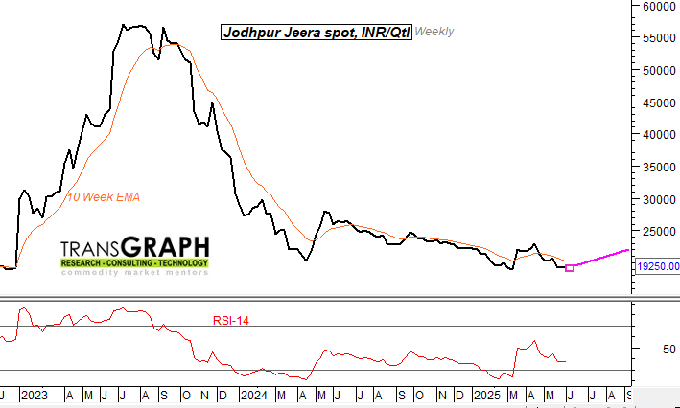
Jodhpur Jeera spot, INR/Qtl
Jodhpur Jeera spot prices are likely to hold support of INR 19000 and gradually move higher toward INR 22000 by Aug’25.
Prices as on 04 June’25

Slide 14
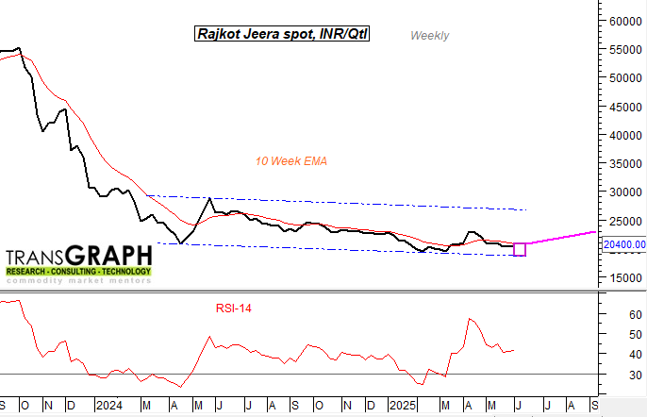
Rajkot Jeera spot, INR/Qtl
Rajkot Jeera spot prices are expected to hold above INR 20000 and trade higher toward INR 23000 level by end of Aug’25.
Prices as on 04 June’25

